Slide 1
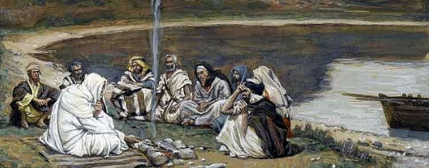
I love thy kingdom lord
I love thy kingdom, Lord, the house of thine abode, the church our blest Redeemer saved with his own precious blood.
2. I love thy church, O God! Her walls before thee stand dear as the apple of thine eye, and graven on thy hand.
3. Beyond my highest joy I prize her heavenly ways Her sweet communion, solemn vows,Her hymns of love and praise.
4. For her my tears shall fall, for her my prayers ascend,
to her my cares and toils be given, till toils and cares shall end.
5. Jesus, Thou Friend Divine, Our Savior and our King, Thy hand from every snare and foe Shall great deliverance bring.

