Slide 1
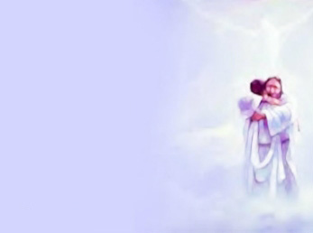
I'm Rejoicing Night and Day
1. I’m rejoicing night and day As I walk the narrow way,
For the hand of God in all my life I see. And the reason of my bliss,
Yes, the secret all is this: That the Comforter abides with me.
2. Once my heart was full of sin, Once I had no peace within,
Till I heard how Jesus died upon the tree. Then I fell down at His feet,
And there came a peace so sweet. Now the Comforter abides with me.
3. He is with me everywhere, And He knows my ev’ry care;
I’m as happy as a bird and just as free. For the Spirit has control;
Jesus satisfies my soul, Since the Comforter abides with me.
4. There’s no thirsting for the things Of the world—they’ve taken wings.
Long ago I gave them up, and instantly All my night was turned to day,
All my burdens rolled away. Now the Comforter abides with me.
Refrain He abides, He abides. Hallelujah, He abides with me!
I’m rejoicing night and day As I walk the narrow way,
For the Comforter abides with me.

